Slide 1
Mid Project Demo- Rover Exploration Game
Dan Parkes
Dap90

Slide 2
Project Outline-
Rover Exploration Game – developed using Unity and Visual Studio Code.
A flat top hex tile rover exploration game. Current premise is navigating a rover to the objective tile whilst conserving battery and navigating tiles of set elevation. Rover can only travel to tiles of equal or adjacent elevation (1 through 5).
VCS- GitHub is used for major project management and storing documents and scripts. Unity Version Control is used to back up entire Unity project (couldn’t operate Git LFS).
TurtleandFrog/MMP-RoverGame: CS39440 Major Project

Slide 3
Feature Driven Development
FDD is used as it provides a structured approach with regular deliverables, and ensures the project is planned and designed at the start. Given weekly supervisor meetings and the fairly simple features, I felt this was the most appropriate.
Initial Issue Board
Menus –
Main Menu, Settings Menu, Pause Menu
Gameplay –
Hexagonal Tilemap, Terrain, Resource Management, Win Condition, UI
Stretch Goals –
Mobile Port, Accessibility Features
Each issue was split into design and implementation.

Slide 4
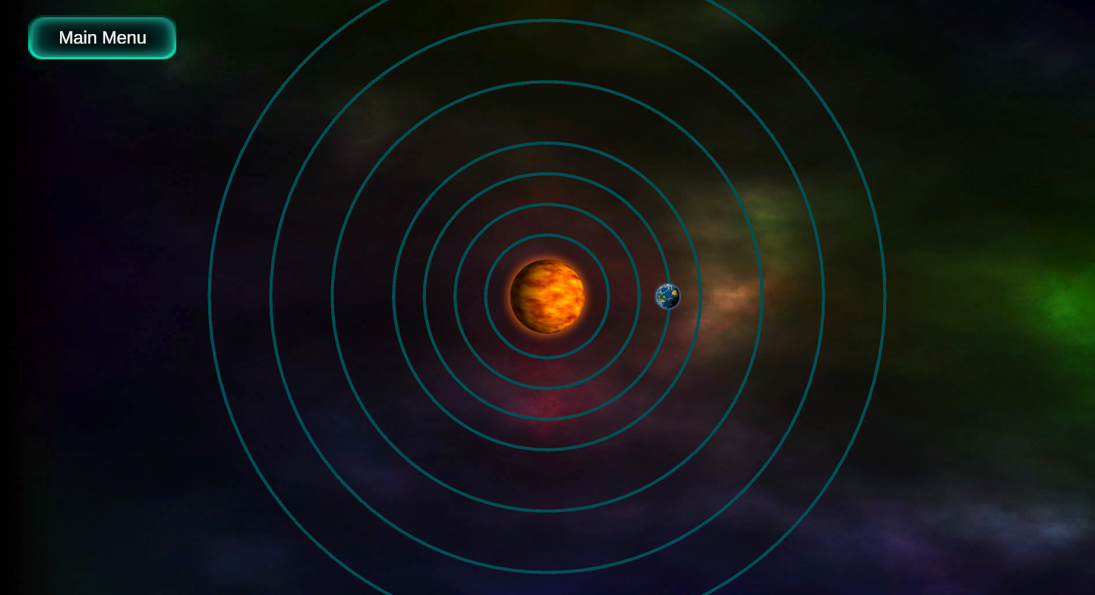
Is the Process Working
Overall, yes. Every week a key feature has been delivered. This has led to a playable demo for the mid week demo.
However, there are things I would change:
Test-Driven Development-
Makes future development much easier.
More Designs before Implementation
Designs make implementing UI incredibly straightforward, especially placeholder UI.

Slide 5
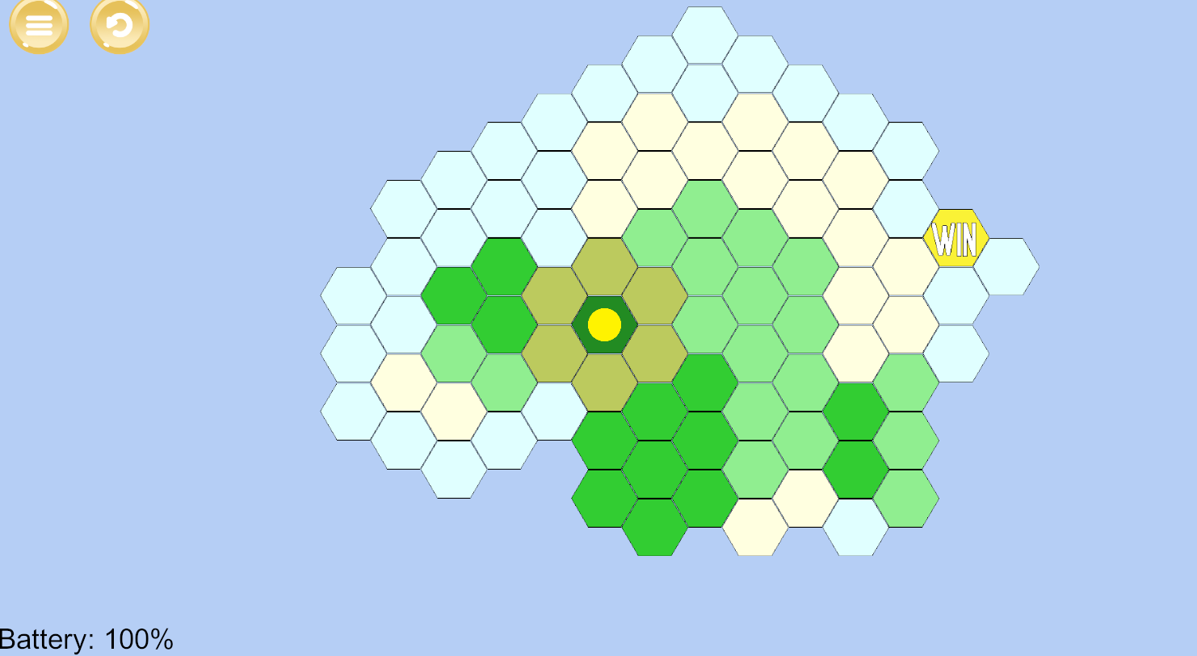
Gameplay
Instead of explaining there’s a demo. Whilst there are several missing features (and one bug by my count) this should provide a basic introduction to the game.
(Might be worth undertaking the demo at the end as my laptop has occasionally blue-screened upon launching unity.)
All assets are merely placeholder assets from the unity asset store/ itch.io. Whilst not referenced here they will be in my final report.

Slide 6
Scripts
Gameplay Scripts-
HexTile – Constructor for each HexTile store 3D coordinates and Elevation Int
HighlightManager – Highlight tiles around a central tile on a separate Tilemap, dependant on if they are matching or adjacent elevations.
ObjectiveManager – Checks if players current position is the same as a win tile. If so activate WinPanel.
Rover – Adds and Undos moves from Rovers path. Can execute path to move rover through each tile, at the cost of 10% battery per tile. Updates UI to represent this.
TileClickDetection – Detects mouse clicks on Tilemap, converting world position to Tilemap position and adding it to rover moves. Also detects “Z” to undo and “Space” to execute path.
TilemapManager – Loops through all tiles upon start and adds their elevation (set by tile colour) to a dictionary with their coordinates.
Unused A* algorithm (Perhaps implemented later) Heavily adapted from various sources on the internet (and buggy for hexes)
Menu Scripts all work the same currently. Pull a scene name from scene name enum and switch scene upon button press. (Besides from a simple line drawer for level select)

Slide 7
What’s Next?
Expand on Objectives ( Various Ideas)
I’ll comment on these more at the end as I’d like your opinion.
Implement Unique Planet Modifiers-
Dust Storms, Fog of War, Icy Surface, Asteroid Impacts, Liquid Terrain etc
Create Shop/Workshop.
Rover Customisation (gameplay & cosmetic)
Implement Settings Menu Features
Audio / SFX
More tailored assets
Mobile Port / Accessibility Features
Debugging & Testing

Slide 8
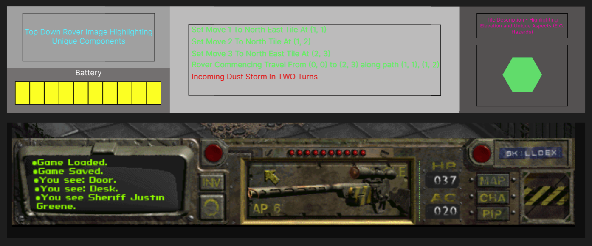
Future UI Designs- Gameplay UI
Inspired by Fallout 1 UI
Much more tactical, slower paced game design

Slide 9
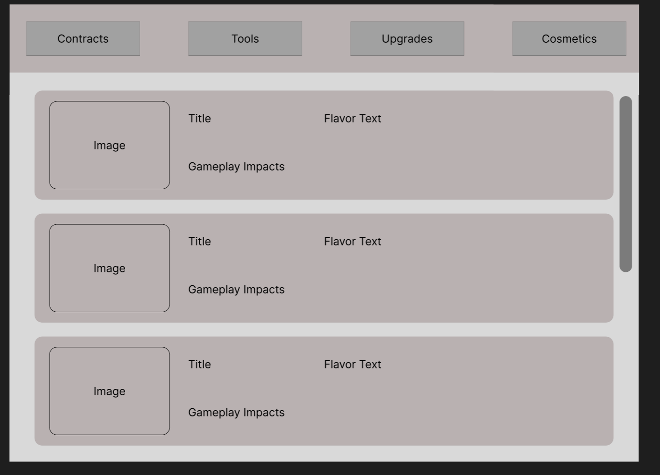
Future UI Designs- Shop
New Tools e.g. traverse higher elevations
Buy New Objectives/Missions
More Battery, More Carry Weight etc
Individual Items

Slide 10
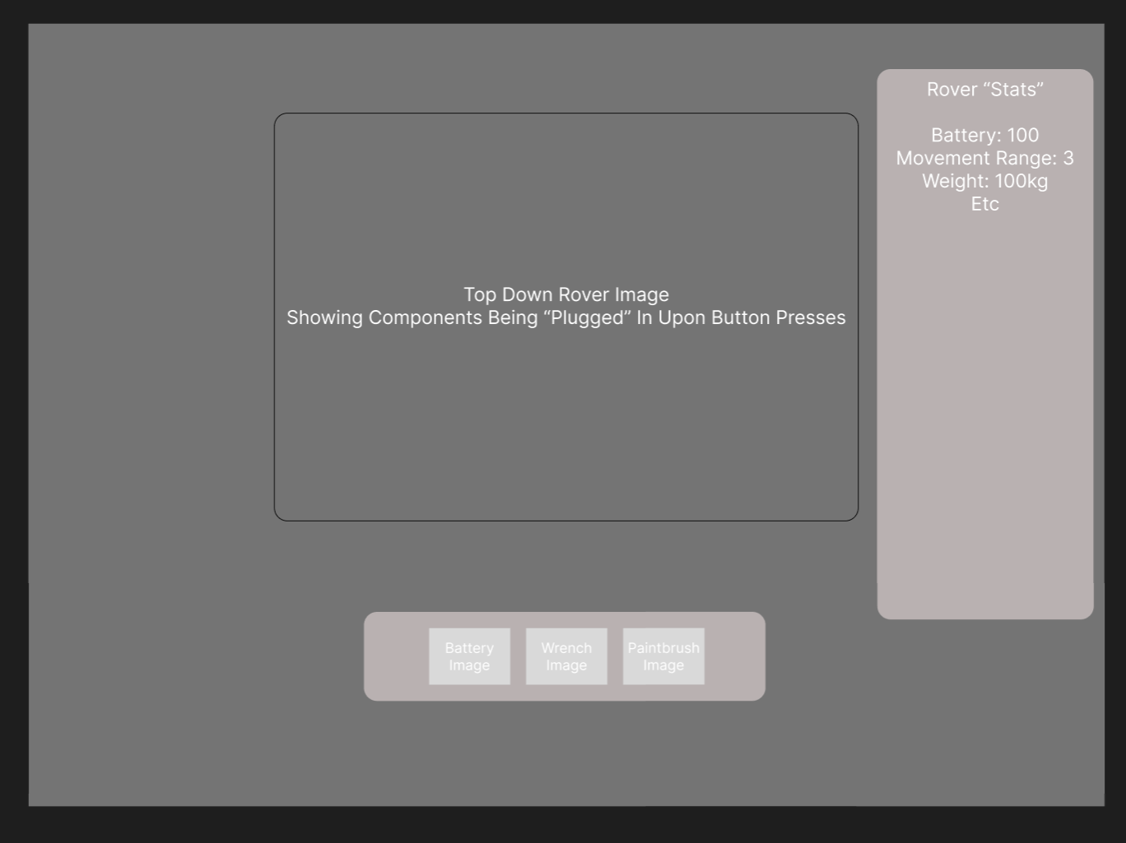
Future UI Designs- Workshop
Can be greatly expanded (or not used)
Inspired by Mario Kart. Cycle through items attach individually for different stats.

Slide 11
Questions For Second Marker
Any opinions on the way I should progress in terms of objectives? Here are my ideas-
A tower defence / base building game. The recover is equipped with tools to gather resources. You must acquire these resources to build defences for the lunar base, or the humans inside will be exposed to a pathogen etc. This allows for quite a range of technical aspects, sticks to the core idea of rover exploration to gather resources, and is more interesting than simple navigation.
Like battleships but with movement and unique weapons. Two rovers (equipped with weapons of some sort) must fire at the enemy, accounting for wind and terrain. This could also be quite technically challenging, and allows for the possibility of multiplayer, but I feel its straying away from the rover exploration idea.
An almost text adventure kind of game mixed with D&D. You navigate to tiles, each one returning text within the UI or adding to a mission log. I feel whilst this keeps to the idea of rover exploration it’s on the less technical side and will involve more story writing than coding/design.
E.g. The rover discovers signs of life. What should it do? Follow Them / Go in the opposite direction
Is mobile implementation too ambitious? (this will depend on the next steps)
Could you suggest any further stretch goals?

